Slide 1

CHAHTA INCHUKKA
Choctaw Nation of Oklahoma
Angela Dancer, Sr. Director
Brandi Smallwood, Director
Tribal Maternal, Infant and Early Childhood Home Visiting Grantee

Slide 2
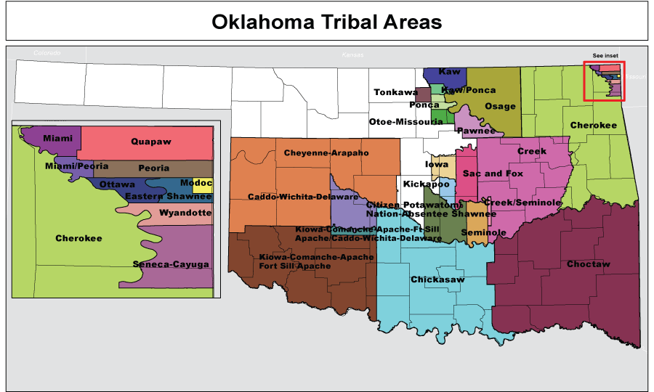
Background information
The Choctaw Nation of Oklahoma serves 90,000 Tribal members scattered through out a 10 ½ county service area in southeastern Oklahoma.
As an integrated Tribe (i.e., not reservation based), the Choctaw Nation service area spans over more than 11,000 square miles of beautiful hill country that is extremely remote, rural, and poverty stricken.
Tribal coverage area is equal to the size of Maryland, Delaware, Rhode Island, and District of Columbia combined.

Slide 3
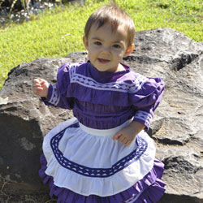
Chahta inchukka
Current Available Data Sources on:
Child Maltreatment
Economic Status
Teen Birth Rates
Education

Slide 4
Child maltreatment
During the 2010 fiscal year, OKDHS found that 7.9 children for every 1,000 children in the state were found to have a substantiated claim of abuse/neglect or both.
Within the Choctaw Nation service area, for the same reporting period, nine counties reported higher rates of child maltreatment than that of the state as a whole.
The highest rate was shown to be in Coal County at 24.6 per 1,000 children affected by abuse/neglect followed by Bryan and Pittsburg with 21.4 and 13.8 respectively.

Slide 5
poverty
The overall economy of the Choctaw Nation service area leaves many of our families in a never ending cycle of hardship.
The Annie E. Casey, KIDS COUNT DATA CENTER lists 9 of the 10 ½ counties in the Nation’s service area as an Economic Cluster 5, indicating they are among the poorest in the state. E.g., Median Household Income for the State of Oklahoma is $41,861. The Median Household Income for Choctaw Nation is $26,403 which is only 63.1% of the state average.
Retrieved March 2011 from Annie E. Casey, KIDS COUNT DATA CENTER, www.datacenter.kidscount.org; “Oklahoma KIDS COUNT Factbook 2010 - County Benchmarks”

Slide 6
Teen birth rate and the percent of children living in single parent households are both factors that contribute to poverty rates.
 | Children age 0-5 living in poverty (Percent) | Teen Birth Rate (Rate per 1000) | Children Living in a Single-Parent Household (Percent) | Uninsured Children under the age of 19 (Percent)
State of Oklahoma | 27.4% | 59 | 32.0% | 12.2%
Atoka | 29.2% | 70 | 30.0% | 11.9%
Bryan | 37.0% | 65 | 40.0% | 10.0%
Choctaw | 37.0% | 91 | 37.0% | 7.5%
Coal | 26.7% | 63 | 34.0% | 15.5%
Haskell | 31.5% | 86 | 20.0% | 9.7%
Hughes | 52.8% | 77 | 49.0% | 13.7%
Latimer | 20.7% | 54 | 23.0% | 9.8%
Le Flore | 37.7% | 78 | 36.0% | 11.4%
McCurtain | 45.7% | 86 | 39.0% | 9.2%
Pittsburg | 21.1% | 70 | 37.0% | 10.6%
Pushmataha | 41.0% | 65 | 33.0% | 11.0%

Slide 7
Lack of education
High School Dropouts by Race; Choctaw Nation Service Area 2006-2007 FY thru 2008-2009 FY

Slide 8
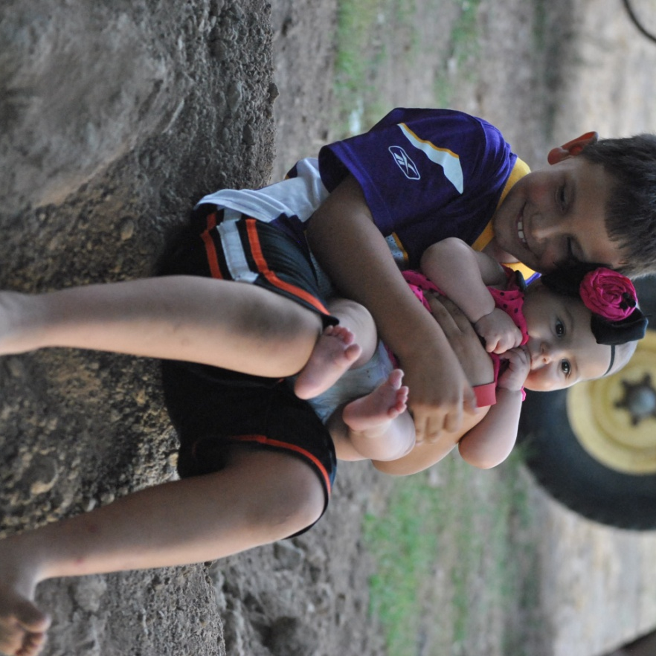
Needs assessment activites
Leadership Team
Community Café
Survey
Focus Group

Slide 9
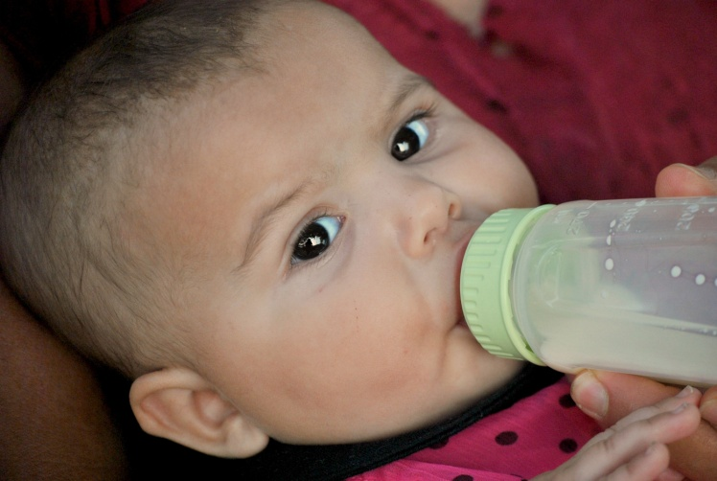
Leadership team
School Superindentant
Former Adolescent Family Life Participants
Former School Teacher
Chahta Inchukka Evaluation Team
CN Head Start
CN Child Care Assistance
CN Support for Pregnant and Parenting Teens
CN Women, Infant, and Children
CN Health Care Services
CN Faith Based Counseling
CN Hokli Nittak
CN Project Youth
CN Victim's Services
Tribal Council Member

Slide 10
HOPE CHART
Identified the Existing Choctaw Nation Services for Children (Prenatal thru Age 8) and their Parents
Parenting Skills
Child Health and Education
Support for Parents/Families
Total of 22 Programs Identified as Available Services

Slide 11
Community cafe
Team members participated in a Community Café to determine the direction they felt the needs assessment should take.
Imagine a community where everyone has the opportunity and encouragement to grow up healthy and well adjusted what would you see, hear and experience in this community?
Think about past and current changes that have taken place in your community, both the positive and the negative. Who or what influences that changes that take place in your community and in what ways?
What needs to happen or change in your community to make it the best possible place for children and families to live happy, healthy and fulfilled lives?
A trial survey was given to CN Head Start administration and faculty.
The Leadership team was provided with the results of the survey

Slide 12
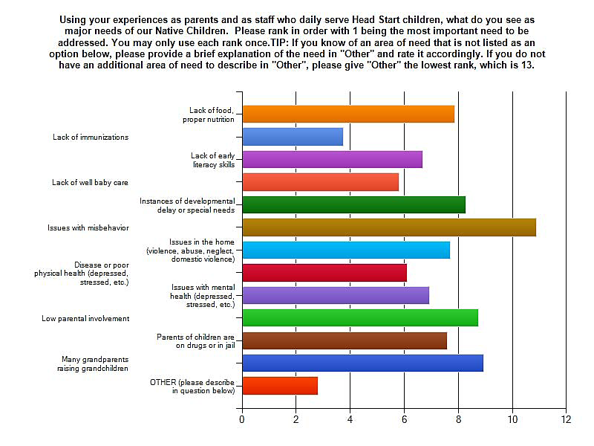
Head Start survey results:

Slide 13
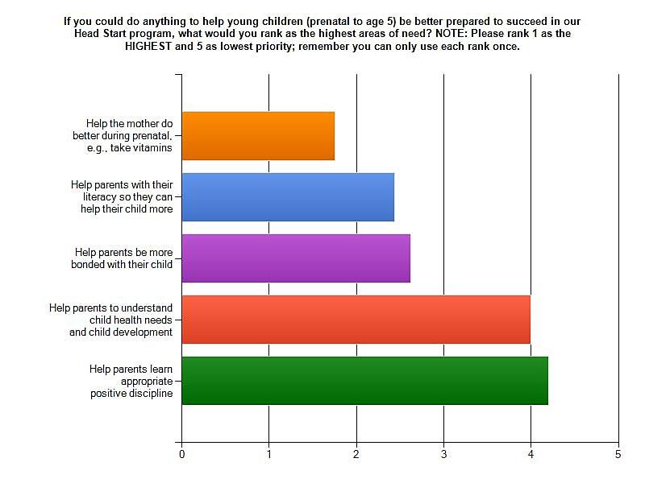
Head Start survey results:

Slide 14
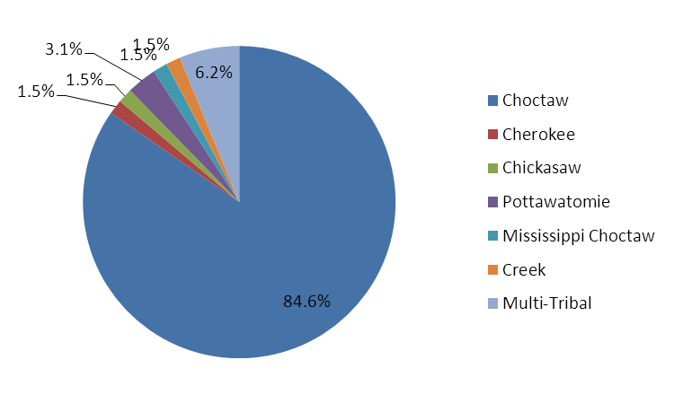
Community Surveys
Participant Groups
Group | Number Surveyed
CN Head Start Parent | 19
CN Daycare Parent | 16
CN AFL Teen Parent | 3
CN WIC Parent | 7
CN Health Clinic Parent | 20
Professional | 29
Native American Affiliation of Participants

Slide 15
FOCUS Groups
Caregiver Role - Participants
Existing Home Visitation Services

Slide 16
Chahta elders
Most focus group participants were either raising grandchildren, had grandchildren placed in foster care and/or grandchildren with autism or autistic tendencies.
Quiet, reserved and a challenge to engage.
Consistent in desire for parenting and child development education; empowering caregivers in parenting skills and being able to detect early signs of concerns in child development.
Stories like this are driving Chahta Inchukka to develop a comprehensive program to provide needed services to guardians and caregivers of young children.

Slide 17
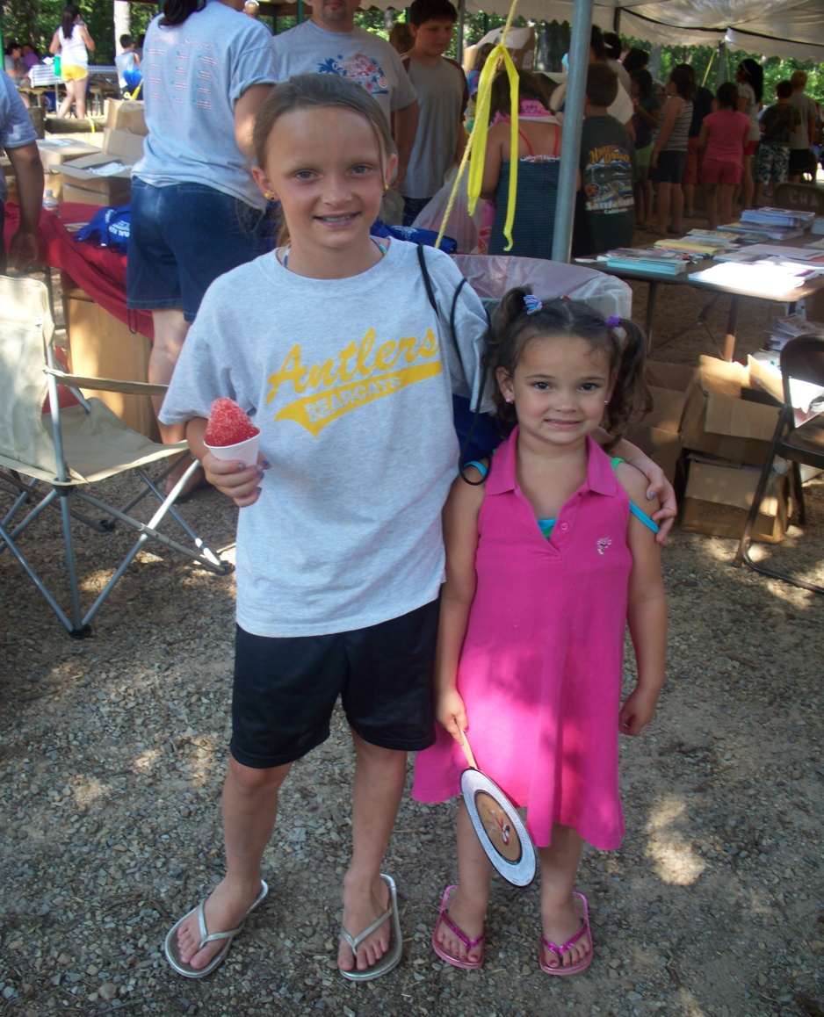
MODEL SELECTION
Identified Areas of Need
Benchmarks and Constructs
Assessments

Slide 18
Identified Areas of need
Improvement of School Readiness
Reduction of Domestic Violence
Improvement of Family Socio-Economic Status
Improvement in Coordination of Referrals to Community Resources and Supports

Slide 19
Preferred Methods of Service Delivery
Method of Service Delivery | Online Survey | Focus Groups
General Group Parent Training Meeting | 29.6% | 19.3%
Individual Home Based Services | 22.2% | 15.9%
Professional In-Office Services | 9.3% | 8.0%
Both General Group Parent Training Mtg. and Individual Home Based Services | 35.2% | 52.3%
Both General Group Parent Training Mtg. and Professional In-Office Services and | 1.9% | 1.1%
No Response | 1.9% | 3.4%

Slide 20

Curriculum
Addressed top 4 areas of need.
Service delivery preference of community.
Promising Approach for Tribal Communities.
Culturally Adaptable
Financially Attainable

Slide 21

Parents as teachers
Development Centered Parenting
Child development
Increase parent knowledge
Parent/Child Activity
School readiness
All areas of child development
Family Well-Being
Total Support

Slide 22
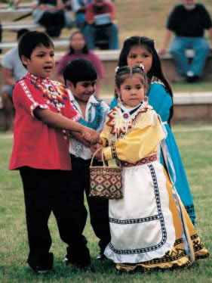
Parents as teachers
Bi-Weekly Home Visits with Monthly Group Meetings
Flexibility and Ease
Vast amount of Information Available
Support of Model Developer
Familiar to Community

Slide 23
Cultural Adaptions
Chahta Inchukka staff chose to use monthly group meetings as their vehicle to provide cultural education to the families.
Positive Indian Parenting: Honoring our Children by Honoring our Traditions – National Indian Child Welfare Association
Traditional Parenting
Lessons of the Storyteller
Lessons of the Cradleboard
Harmony in Child Rearing
Traditional Behavior Mgmt.
Lessons of Mother Nature
Praise in Traditional Parenting
Choices in Parenting

Slide 24
Benchmarks: Data Collection
Benchmark 1: Improved Maternal and Newborn Health (9)
Benchmark 2: Child Injuries, Child Abuse, Neglect or Maltreatment, and Reduction of Emergency Department Visits (7)
Benchmark 3: Improvement in School Readiness and Achievement (9)
Benchmark 4: Domestic Violence (3)
Benchmark 5: Family Economic Self-Sufficiency (3)
Benchmark 6: Coordination and Referrals for Other Community Resources and Supports (5)

Slide 25
Instruments: Data Collection
Ages and Stages, 3rd Edition
Ages and Stages – Social Emotional
Edinburgh Postnatal Depression Screening
Keys to Interactive Parenting Scale
Women’s Experience with Battering
Intake Form (adult, child)
Referral and Referral Follow-up
Home Safety Checklist
Family Needs Screening
Client Survey
Safety Plans
HV Records

Slide 26
Staff Support / fidelity
Reflective Supervision
Weekly one-on-one with supervisor
Monthly group reflections
Once monthly home visits with supervisor
HOVRS Rating Scale
Case Reviews
Monthly client case review and client interview
Monthly Reports
Evaluation
Bi-Annual Basis

Slide 27

Next steps…….
Completion and Approval of Benchmark Plans
Development of Data Collection Instruments
Research Design for Evaluation
Increased Dissemination Activities
Trial Run of Date Collection Instruments
Full Implementation

Slide 28
